Slide 1
19CSE313 – Principles of Programming Languages
Basic Types and Operations

Slide 2
Some basic types
Basic Type | Range
Byte | 8-bit signed two's complement integer (-27 to 27 - 1, inclusive)
Short | 16-bit signed two's complement integer (-215 to 215 - 1, inclusive)
Int | 32-bit signed two's complement integer (-231 to 231 - 1, inclusive)
Long | 64-bit signed two's complement integer (-263 to 263 - 1, inclusive)
Char | 16-bit unsigned Unicode character (0 to 216 - 1, inclusive)
String | a sequence of Chars (java.lang)
Float | 32-bit IEEE 754 single-precision float
Double | 64-bit IEEE 754 double-precision float
Boolean | true or false
Note: Collectively, types Byte, Short, Int, Long, and Char are called integral types.
The integral types plus Float and Double are called numeric types.
All types other than string are members of scala package

Slide 3
Literals (constants)
All of the basic types listed in Table 5.1 can be written with literals
Integer literals:
Integer literals for the types Int, Long, Short, and Byte come in two forms: decimal and hexadecimal.
The way an integer literal begins indicates the base of the number.
If the number begins with a 0x or 0X, it is hexadecimal (base 16), and may contain 0 through 9 as well as upper or lowercase digits A through F.
Some examples are:
scala> val hex = 0x5
hex: Int = 5
scala> val hex2 = 0x00FF
hex2: Int = 255
scala> val magic = 0xcafebabe
magic: Int = -889275714
Note that the Scala shell always prints integer values in base 10, no matter what literal form you may have used to initialize it.
Thus the interpreter displays the value of the hex2 variable you initialized with literal 0x00FF as decimal 255.

Slide 4
Decimal literals
If the number begins with a non-zero digit, and is otherwise undecorated, it is decimal (base 10).
For example:
scala> val dec1 = 31
dec1: Int = 31
scala> val dec2 = 255
dec2: Int = 255
scala> val dec3 = 20
dec3: Int = 20

Slide 5
Long literals
If an integer literal ends in an L or l, it is a Long; otherwise it is an Int.
Example:
scala> val prog = 0XCAFEBABEL
prog: Long = 3405691582
scala> val tower = 35L
tower: Long = 35
scala> val of = 31l
of: Long = 31

Slide 6
Short or byte
If an Int literal is assigned to a variable of type Short or Byte, the literal is treated as if it were a Short or Byte type so long as the literal value is within the valid range for that type.
For example:
scala> val little: Short = 367
little: Short = 367
scala> val littler: Byte = 38
littler: Byte = 38

Slide 7
Floating point literals
Floating point literals are made up of decimal digits, optionally containing a decimal point, and optionally followed by an E or e and an exponent.
Example:
scala> val big = 1.2345
big: Double = 1.2345
scala> val bigger = 1.2345e1
bigger: Double = 12.345
scala> val biggerStill = 123E45
biggerStill: Double = 1.23E47
Note that the exponent portion means the power of 10 by which the other portion is multiplied. Thus, 1.2345e1 is 1.2345 times 101, which is 12.345.

Slide 8
Float literals
If a floating-point literal ends in an F or f, it is a Float; otherwise it is a Double.
Optionally, a Double floating-point literal can end in D or d.
Some examples of Float literals:
scala> val little = 1.2345F
little: Float = 1.2345
scala> val littleBigger = 3e5f
littleBigger: Float = 300000.0
That last value expressed as a Double could take these (and other) forms:
scala> val anotherDouble = 3e5
anotherDouble: Double = 300000.0
scala> val yetAnother = 3e5D
yetAnother: Double = 300000.0

Slide 9
Character literals
Character literals are composed of any Unicode character between single quotes, such as:
scala> val a = 'A'
a: Char = A
Character literals are composed of any Unicode character between single quotes, such as:
scala> val a = 'A'
a: Char = A
In fact, such Unicode characters can appear anywhere in a Scala program. For instance you could also write an identifier like this:
scala> val B\u0041\u0044 = 1
BAD: Int = 1

Slide 10
Escape sequences
Literal | Meaning
\n | line feed (\u000A)
\b | backspace (\u0008)
\t | tab (\u0009)
\f | form feed (\u000C)
\r | carriage return (\u000D)
\" | double quote (\u0022)
\' | single quote (\u0027)
\\ | backslash (\u005C)
Example:
scala> val backslash = '\\'
backslash: Char = \

Slide 11
String literals
A string literal is composed of characters surrounded by double quotes:
scala> val hello = "hello"
hello: String = hello
The syntax of the characters within the quotes is the same as with character literals.
For example:
scala> val escapes = "\\\"\'"
escapes: String = \"'

Slide 12
Boolean literals
The Boolean type has two literals, true and false:
scala> val bool = true
bool: Boolean = true
scala> val fool = false
fool: Boolean = false

Slide 13
String interpolation
Allows you to embed expressions within string literals
Provides a concise and readable alternative to string concatenation
scala> val name = "reader"
val name: String = reader
scala> println(s"Hello, $name!")
Hello, reader!
scala> s"The answer is ${6 * 7}."
val res2: String = The answer is 42.

Slide 14
Operators
Operators are methods
For example, 1 + 2really means the same thing as 1.+(2).
In other words, class Int contains a method named +that takes an Int and returns an Int result.
This + method is invoked when you add two Ints:
scala> val sum = 1 + 2 // Scala invokes 1.+(2)
sum: Int = 3
scala> val sumMore = 1.+(2)
sumMore: Int = 3
scala> val longSum = 1 + 2L // Scala invokes 1.+(2L) – overloaded version
longSum: Long = 3

Slide 15
Types of operators
Type | Symbol
Unary | -
Arithmetic | +, -, *, / , %
Relational | >, <, >=, <=, !
Logical | &&, ||, !, (&,| to evaluate R.H.S)
Bitwise | &, | , ^, ~ (complement)
Shift | <<, >>, >>> (unsigned shift right)
Object Equality | ==, !=

Slide 16
Operator precedence
Operator | Precedence
* / % | 1
+ - | 2
: | 3
= ! | 4
< > | 5
& | 6
^ | 7
| | 8
All letters | 9
All operators | 10

Slide 17
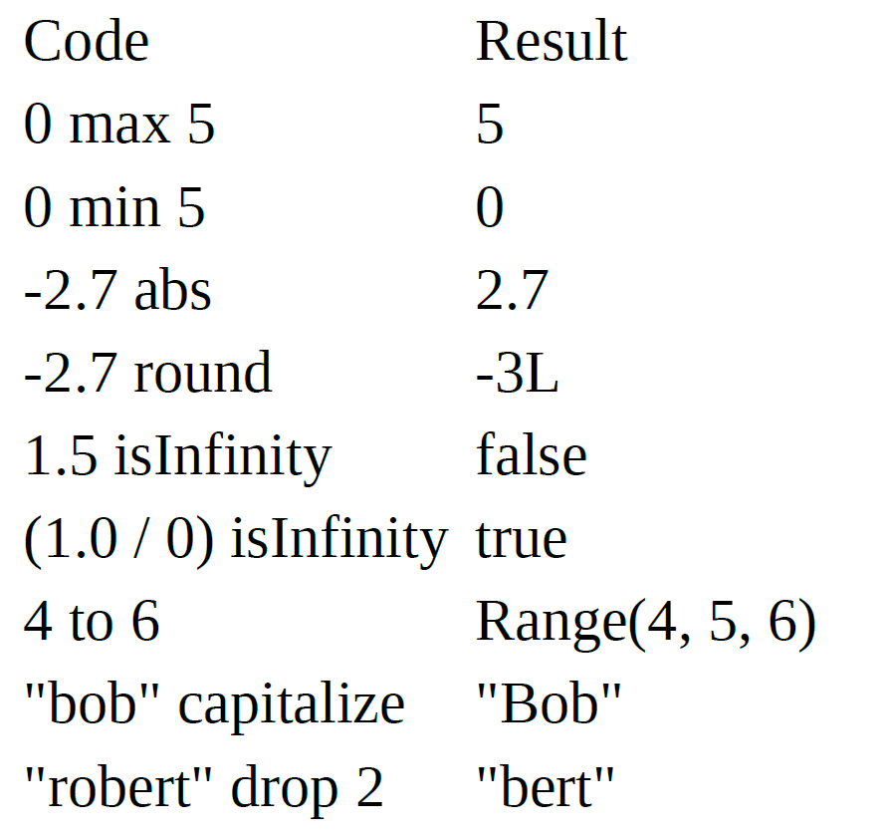
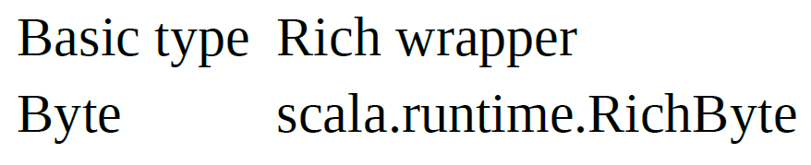
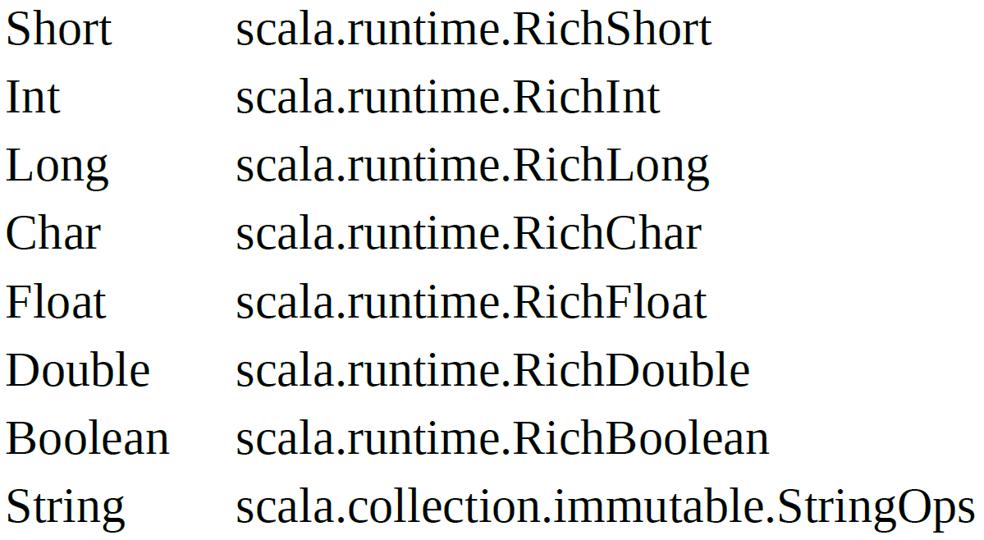
Rich Wrapper classes and operations

Slide 18
Thank you

